Slide 1
Metadata & Quality
Alessandro Di Girolamo

Slide 2
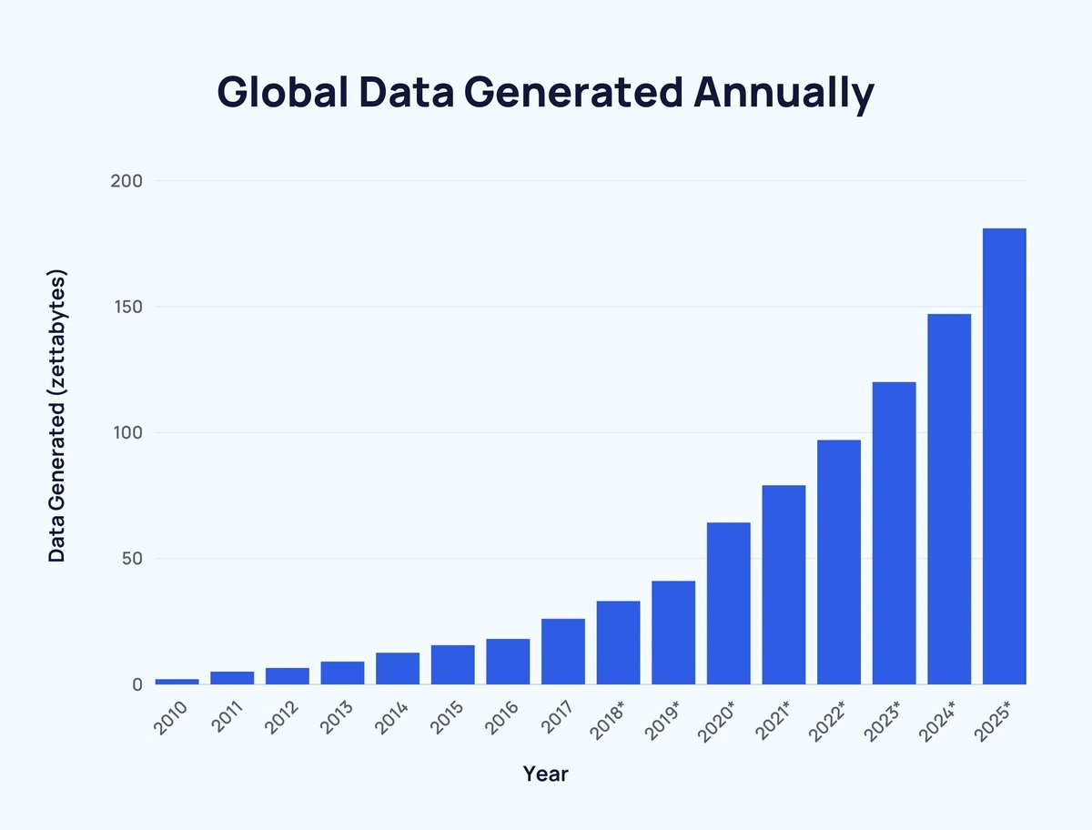
The growth in data quantity is exponential.
(includes data that is newly generated, captured, copied, or consumed)
Video is responsible for over half (53.72%) of all global data traffic.

Slide 3
Some types of metadata
Descriptive
Structural
Used to identify, find, and discover content
Describes the internal structure or relationships between resources
Provenance (or Statistical)
Social
Describes the origin of data, how it was collected, and any transformations
Includes user comments, tags, reactions, or usage-related data

Slide 4
From Structure to Trust
Metadata is the key in the digital world because it gives data context, structure, and meaning.
Good metadata quality is also the key to make sure that data is trustworthy and easy to use.
When metadata is clear and well organized people understand and work with data better.

Slide 5
Best practices for improving metadata
Gamification
Making metadata management fun and rewarding (points, challenges, prizes) increases engagement.
Self-regulating communities (like StackOverflow) with visible feedback (upvotes, comments, badges).
Implementing social evaluation mechanisms (e.g., ratings, answering questions) increases metadata reliability.
High-trust environment
Training and recognition
Internal education programs (certifications, short courses, “metadata academy”) with public recognition.
Evaluating and publicly rewarding improvement creates a positive adoption loop

Slide 6
AI & LLM Innovations in Metadata Management

Slide 7
Automate metadata generation
Recent AI technologies are transforming metadata systems, automating tasks that were traditionally manual.
The automation of this process has increased the number of metadata but has also increased the risk of having a low quality of them.

Slide 8



Some Key Applications
Automated Metadata Description
Platforms like Alation, Collibra, and DataHub use generative AI to create descriptions for datasets, columns, and tables.
Semantic Classification & Tagging
ML is used to automatically tag sensitive data, glossary terms, and classifications.
Smart Lineage and Governance
Smart lineage automatically tracks where data comes from, how it changes, and where it goes, offering full visibility and traceability.
Smart governance uses AI and automation to enforce data policies, ensure quality and support compliance.

Slide 9


Risks & mitigation strategies for ai in metadata
Hallucinations
Human-in-the-Loop
LLMs can fabricate plausible but false information.
Most tools require human validation of generated metadata.
Bias
Data Quality Controls
AI outputs can reflect and amplify biases present in training data.
Anomaly detection to ensure the AI isn’t trained on poor-quality inputs.
Lack of transparency
Explainability
LLMs are often black boxes; users may not understand why a suggestion was made.
The ability of a system to clearly explain how and why it made a specific decision or produced a certain outcome.
Compliance/privacy
Privacy-Safe AI Integration
Improper use of AI tools can leak sensitive metadata or violate regulations.
Ensure metadata stays within internal environments.
Overtrust
Fairness and Bias Monitoring
Users may accept AI suggestions without verifying accuracy.
Feeding the AI with balanced and rich contextual data can prevent distorted suggestions.

Slide 10
Final Thoughts
The growth of metadata is closely linked to the growth of data.
It’s crucial to adopt innovative methodologies to scale metadata generation; it’s also important to maintain high standards of accuracy and quality.

Slide 11
Thank you for your attention
Alessandro Di Girolamo

